Slide 1
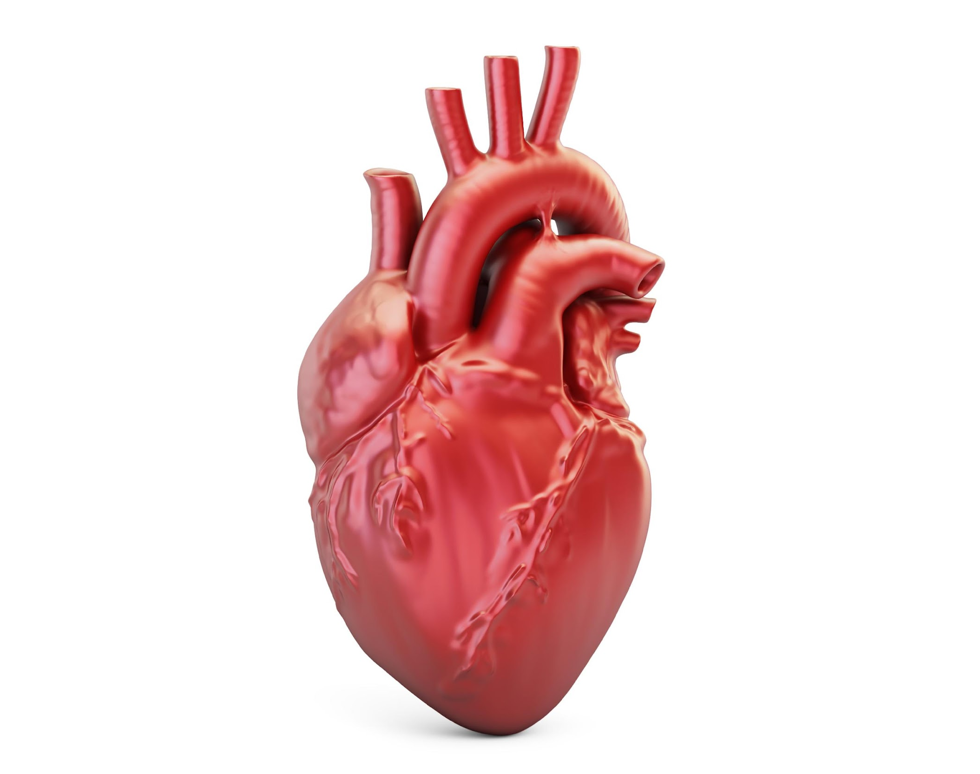
Heart Disease Prediction using Machine Learning
Hardik Gehlot, Gustavo Cupertino,
Varun Vinodh & Bhuvana Krish

Slide 2
Introduction
Heart disease or Cardiovascular disease is widespread in Canada, affecting millions of people. According to the Heart and Stroke Foundation of Canada, heart disease accounts for approximately 29% of all deaths in the country.
Several risk factors contribute to the development of heart disease. These include high blood pressure, high cholesterol levels, smoking, obesity, diabetes, sedentary lifestyle, poor diet, family history of heart disease, and age.
Source: Heart & Stroke Foundation

Slide 3
Purpose
By leveraging machine learning algorithms and analyzing data related to risk factors such as age, race, body mass index, previous conditions such as stroke, asthma and kidney disease and behavioral aspects such as smoking and alcohol consumption, the project aims to develop an accurate predictive model.
This model can help identify individuals at high risk of developing heart disease, enabling timely interventions, personalized treatment plans, and targeted preventive measures, ultimately leading to improved cardiac health and reduced healthcare costs.
Disclaimer: Our prediction model is intended as a supplementary tool and shouldn’t be considered a replacement to existing prediction methods in the healthcare industry.

Slide 4
Data Collection
The original dataset was published by the Centers for Disease Control and Prevention (CDC) and is a major part of the 2020 Behavioral Risk Factor Surveillance System (BRFSS) Survey.
It consisted of 401,958 rows and 279 columns, which was subsequently reduced to about 20 variables to be better suitable for machine learning methods.
The resultant dataset consists of 319795 rows and 20 columns, which we used for our project.
Data Source: Kaggle

Slide 5
Languages / Libraries
Programming Language - Python
Development Environment - Jupyter notebook
Data Manipulation and Analysis - Pandas Library
Data Visualization - Tableau
Machine learning - Scikit-learn and Pickle Libraries
Random Forest and Linear Regression Models
Web Application Development - Streamlit (open-source framework)

Slide 6
Data Exploration and Visualization
Data Loading: csv data file into a Pandas DataFrame
Data Summary: identifying data types for conversion
Data Cleaning: handling missing values, removing irrelevant columns, and
data transformation
Data Visualization: gaining insights and patterns identification; relationship between features and target variable
In this work the heart disease risk factors were treated as features while the heart disease status was our target variable.

Slide 7
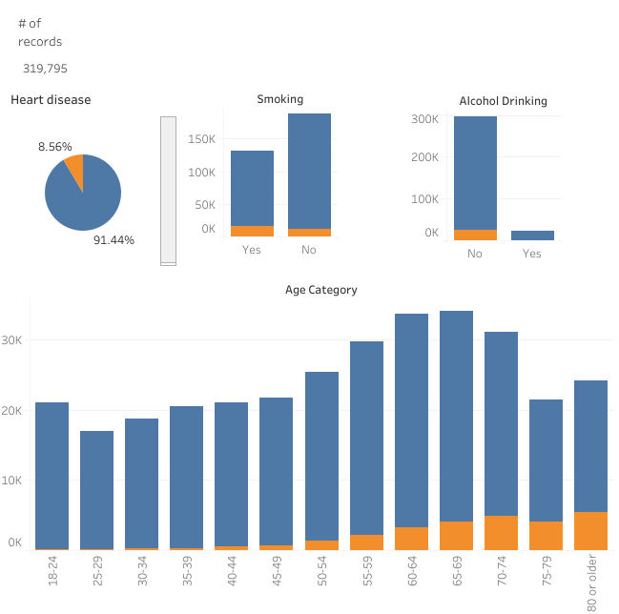
Tableau Public - Heart-disease risk factors relationships

Slide 8
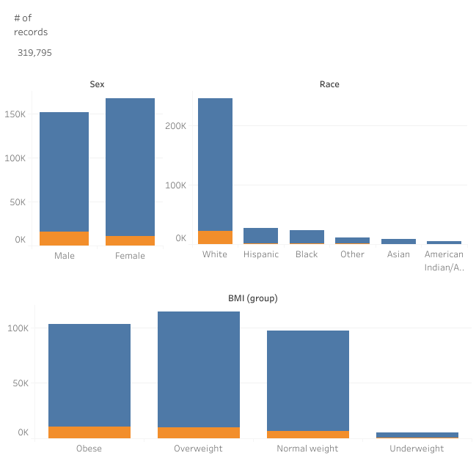
Tableau Public - Heart-disease risk factors relationships

Slide 9
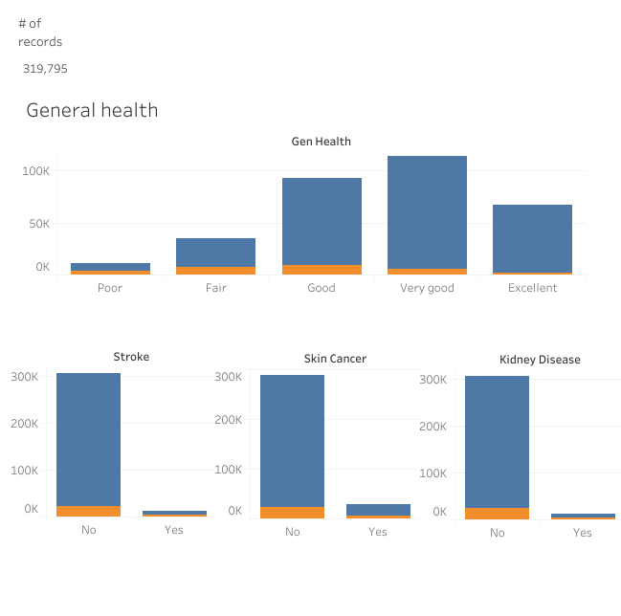
Tableau Public - Heart-disease risk factors relationships

Slide 10
Supervised Machine Learning
The Data set is binary and linear in nature, hence we are using regression models to distinguishing the data.
Model blueprint :
We have used two models:
Random forest Classifier
Logistic Regression
STEP-2
Using Random over sampler, we are balancing the target data in the dataframe.
STEP-1
Converting String data to
Numerical Category using
pd.get_dummies()
STEP-3
Bining the low occurrence data in the dataset.
STEP-4
Splitting the Data-frame into target and features
STEP-6
Building the model and deploying as a pickle file
STEP-5
Scaling the test and train dataset using StandardScaler()

Slide 11
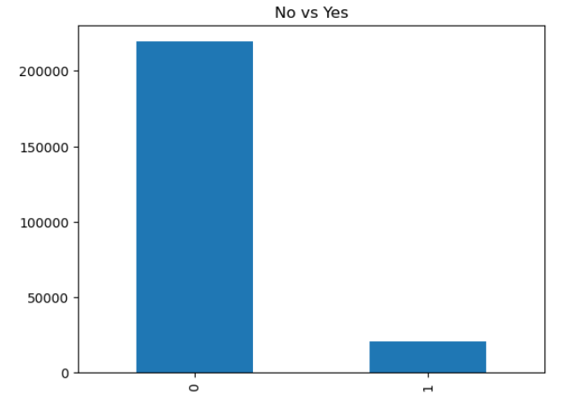
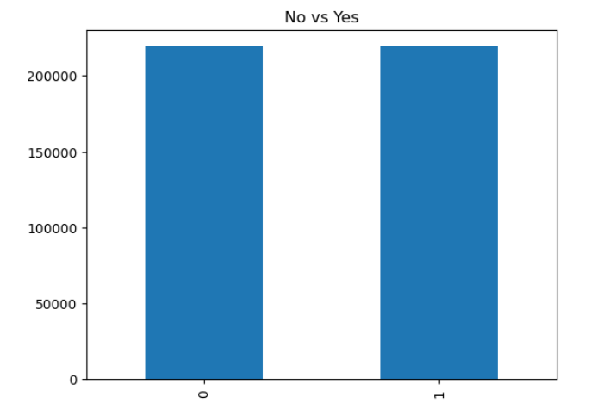
Balancing the target
Random Over sampler
The target values in the dataset was greatly imbalanced
The balancing was done using Random Over Sampler.
The target values in the dataset is balanced
Ideal data for training a model

Slide 12
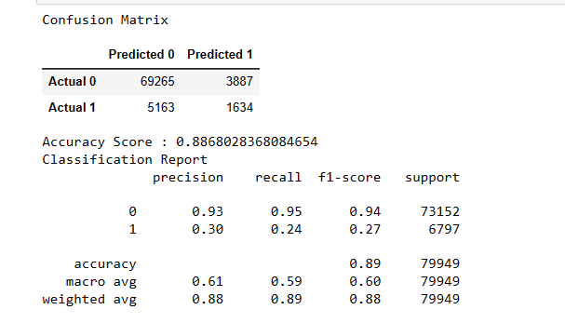
Random Forest Classifier
The datasets are
X_train = BMI, General Health, Race ,Smoking, Alcohol Drinking, Age, Gender and Daily Exercise
Y_train = Historic heart disease data
Outcome:
Precision: It was able to predict outcome “1” with 30% and “0” with 93% relative to total positive prediction.
Recall: It was able to predict outcome “1” with 24% and “0” with 95% relative to total actual positive.
F1-Score: A weighted harmonic mean of precision and recall. The closer to 1, the better the model. we got .24 for “1” and .94 for “0”
Result:
The model cannot be used because it is poorly predicting “1”

Slide 13
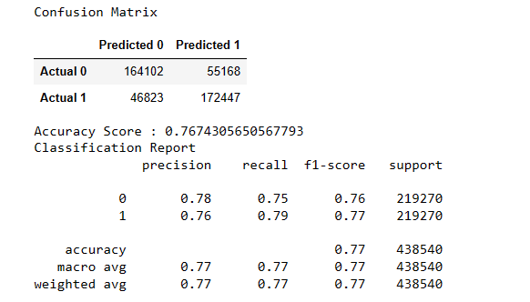
Logistic Regression
The datasets are
X_train = BMI, General Health, Race , Smoking, Alcohol Drinking, Age, Gender and Daily Exercise
Y_train = Historic heart disease data
Outcome:
Precision: It was able to predict outcome “1” with 76% and “0” with 78% relative to total positive prediction.
Recall: It was able to predict outcome “1” with 79% and “0” with 75% relative to total actual positive.
F1-Score: we got .77 for “1” and .76 for “0”
Result:
The model can be used because it is fairly and equally predicting “1” and “0”

Slide 14
Streamlit App
We used Python’s Streamlit library to help create a webapp for our heart disease prediction model.
Heart Disease App Demo

Slide 15
Limitations
We ended up reducing the number of features, in order to fit the prediction model. This might have affected the accuracy and the comprehensiveness of the model.
Please note that our model's predictions should not be treated as a substitute for medical diagnosis. Due to the model's imperfect accuracy, healthcare institutions may not adopt it. For any health concerns, it is crucial to consult qualified medical professionals for accurate diagnosis and personalized medical advice.

Slide 16
Conclusion
Machine learning has demonstrated significant potential in revolutionizing healthcare by enabling improved and early health care assessments.
By implementing machine learning in healthcare, we can anticipate early self - diagnosis in patient conditions, leading to quick recovery and potentially reduce healthcare costs and deaths due to late detection.
As the field continues to evolve, the integration of machine learning in healthcare holds promise for transforming the industry, delivering more effective and efficient healthcare services to individuals worldwide.

Slide 17
THANK YOU

